Slide 1


Slide 2
Technical Note 7
Process Capability and Statistical Quality Control

Slide 3
OBJECTIVES
Process Variation
Process Capability
Process Control Procedures
  Variable data
  Attribute data
Acceptance Sampling
  Operating Characteristic Curve
Notes:
2

Slide 4
Basic Forms of Variation
Example: A poorly trained employee that creates variation in finished product output.
Assignable variation is caused by factors that can be clearly identified and possibly managed
Common variation is inherent in the production process
Example: A molding process that always leaves “burrs” or flaws on a molded item.
Notes:
3

Slide 5
Taguchi’s View of Variation
Traditional view is that quality within the LS and US is good and that the cost of quality outside this range is constant, where Taguchi views costs as increasing as variability increases, so seek to achieve zero defects and that will truly minimize quality costs.
High
High
Incremental
Cost of
Variability
Incremental
Cost of
Variability
Zero
Zero
Lower
Spec
Target
Spec
Upper
Spec
Exhibits TN7.1 & TN7.2
Lower
Spec
Target
Spec
Upper
Spec
Traditional View
Taguchi’s View
Notes:
30

Slide 6
Process Capability
Process limits
Tolerance limits
How do the limits relate to one another?
Notes:
28

Slide 7
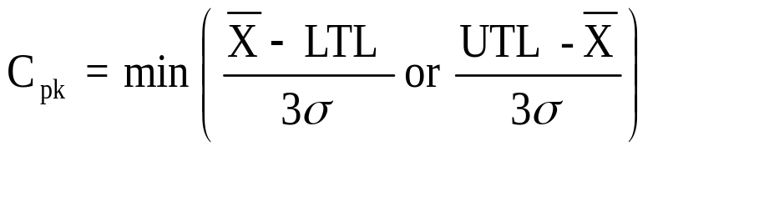
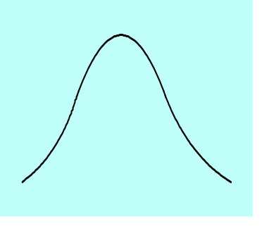
Process Capability Index, C_{pk}
Capability Index shows how well parts being produced fit into design limit specifications.
As a production process produces items small shifts in equipment or systems can cause differences in production performance from differing samples.
Shifts in Process Mean
Notes:
29

Slide 8
Types of Statistical Sampling
Attribute (Go or no-go information)
  Defectives refers to the acceptability of product across a range of characteristics.
  Defects refers to the number of defects per unit which may be higher than the number of defectives.
  p-chart application
Variable (Continuous)
  Usually measured by the mean and the standard deviation.
  X-bar and R chart applications
Notes:
6

Slide 9
Statistical
Process
Control
(SPC) Charts
UCL
Normal Behavior
LCL
1 2 3 4 5 6
Samples over time
UCL
Possible problem, investigate
LCL
1 2 3 4 5 6
Samples over time
UCL
Possible problem, investigate
LCL
1 2 3 4 5 6
Samples over time
Notes:
16

Slide 10
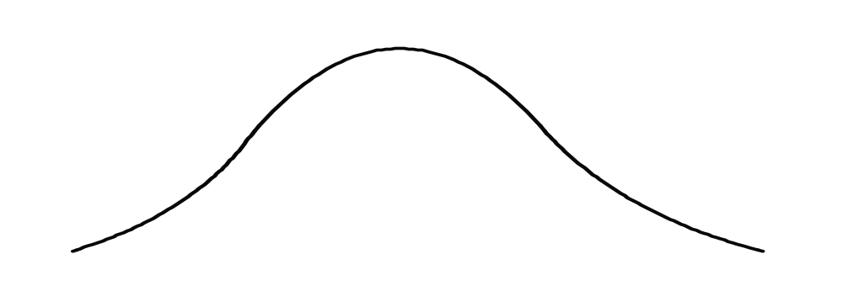
Control Limits are based on the Normal Curve
x
μ
z
-3
-2
-1
0
1
2
3
Standard deviation units or “z” units.
Notes:
14

Slide 11

Control Limits
We establish the Upper Control Limits (UCL) and the Lower Control Limits (LCL) with plus or minus 3 standard deviations from some x-bar or mean value. Based on this we can expect 99.7% of our sample observations to fall within these limits.
99.7%
x
LCL
UCL
Notes:
15

Slide 12
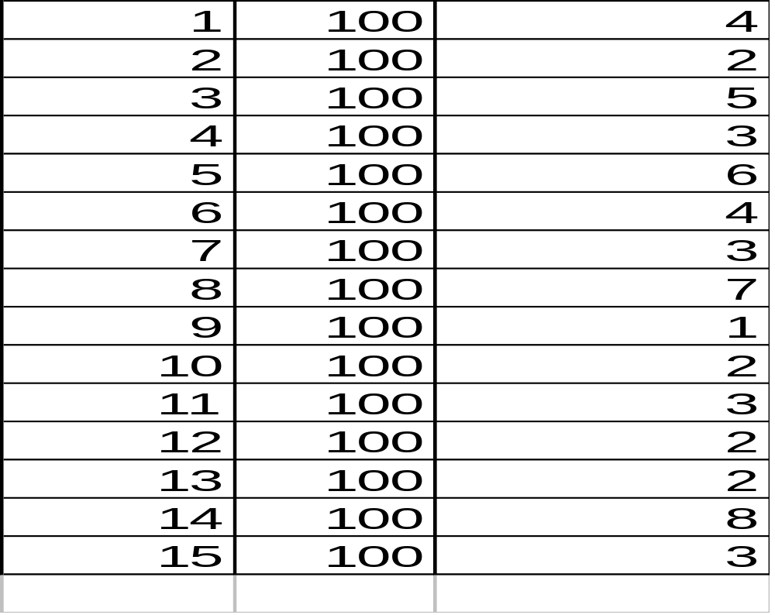
Example of Constructing a p-Chart:
Required Data
Sample
No.
No. of
Samples
Number of defects found in each sample
Notes:
17

Slide 13
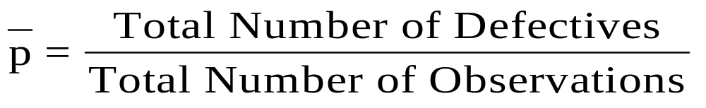
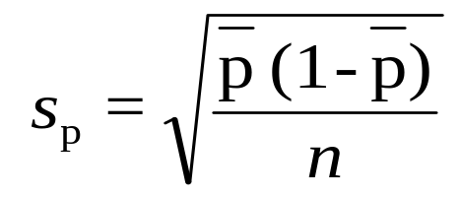
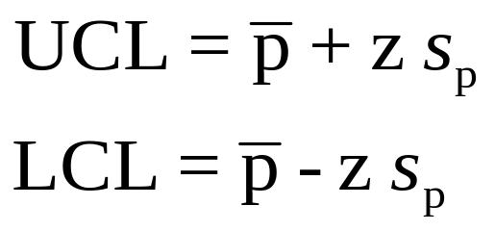
Statistical Process Control Formulas:
Attribute Measurements (p-Chart)
Given:
Compute control limits:
Notes:
18

Slide 14
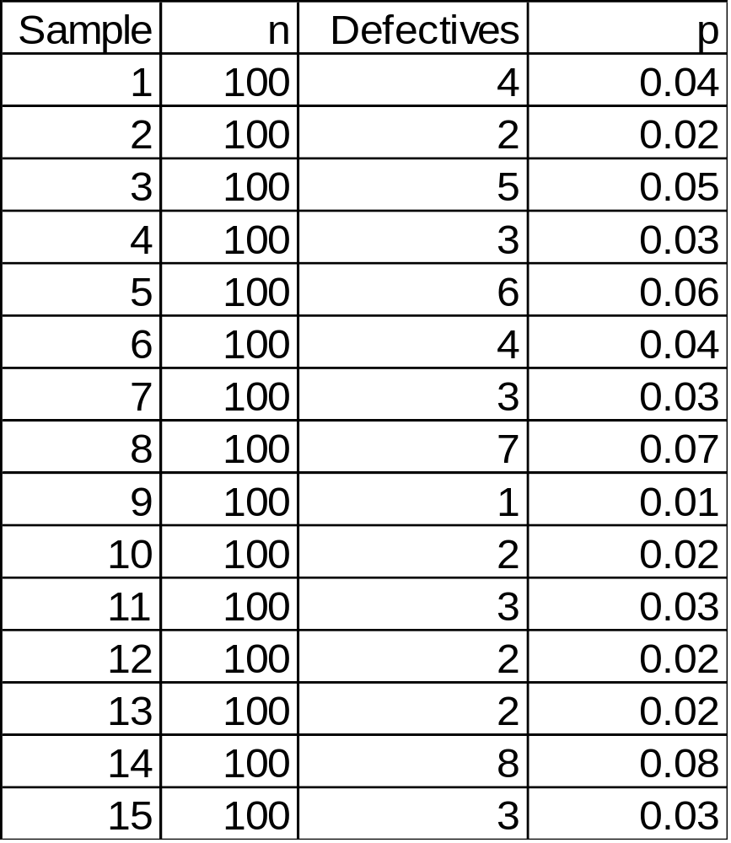

Example of Constructing a p-chart: Step 1
1. Calculate the sample proportions, p (these are what can be plotted on the p-chart) for each sample
Notes:
19

Slide 15
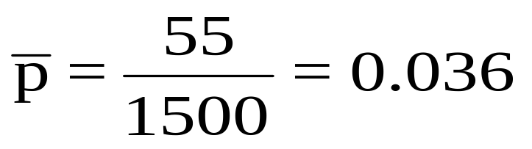
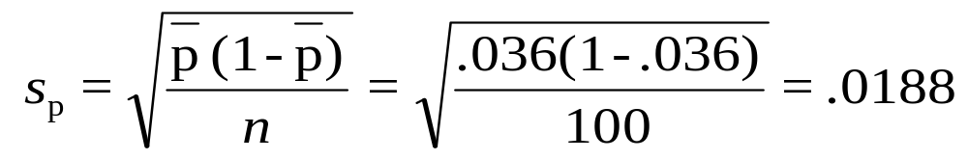
Example of Constructing a p-chart: Steps 2&3
2. Calculate the average of the sample proportions
3. Calculate the standard deviation of the sample proportion
Notes:
20

Slide 16

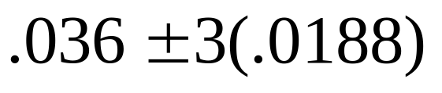
Example of Constructing a p-chart: Step 4
4. Calculate the control limits
UCL = 0.0924
LCL = -0.0204 (or 0)
Notes:
21

Slide 17
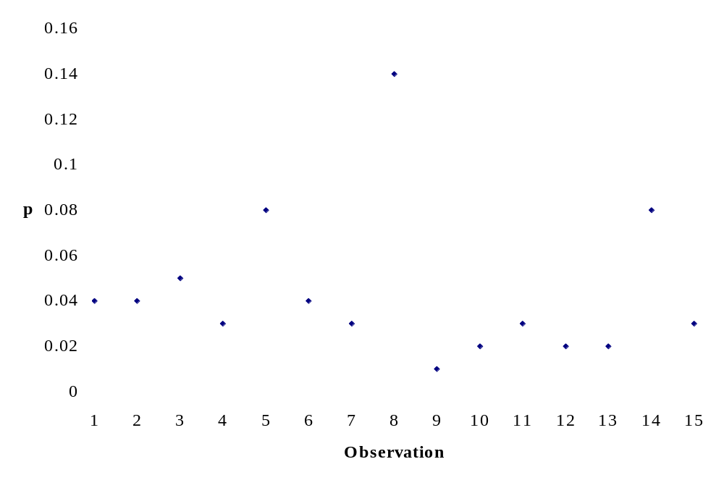
Example of Constructing a p-Chart: Step 5
5. Plot the individual sample proportions, the average
of the proportions, and the control limits
UCL
LCL

Slide 18
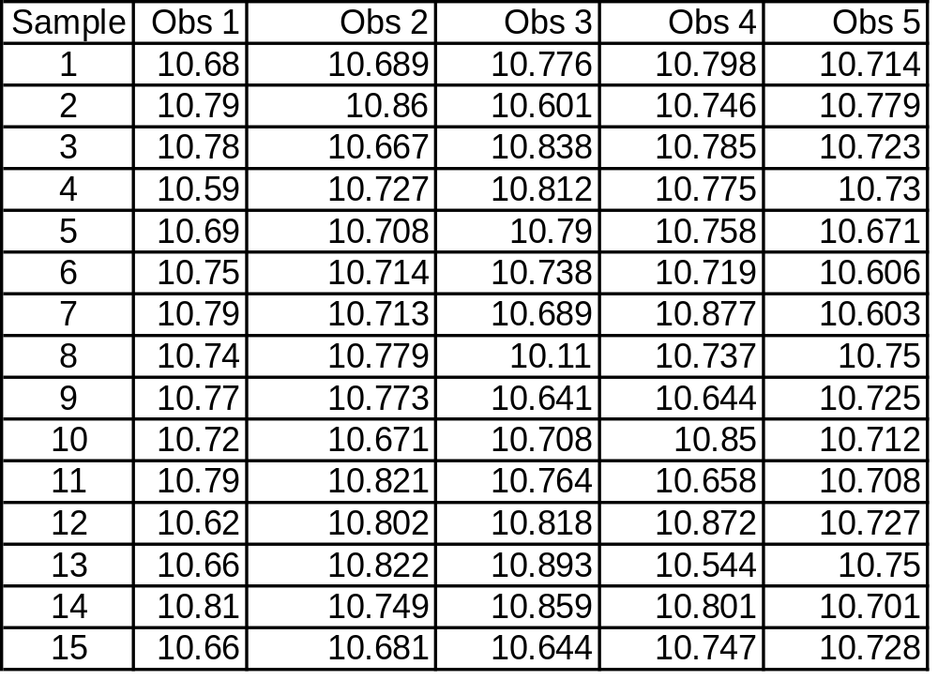
Example of x-bar and R Charts:
Required Data
Notes:
23

Slide 19
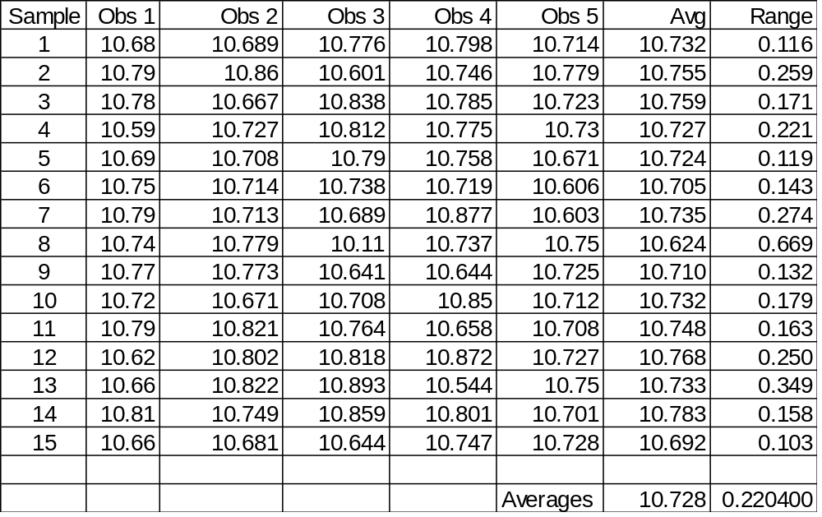
Example of x-bar and R charts: Step 1. Calculate sample means, sample ranges, mean of means, and mean of ranges.
Notes:
24

Slide 20
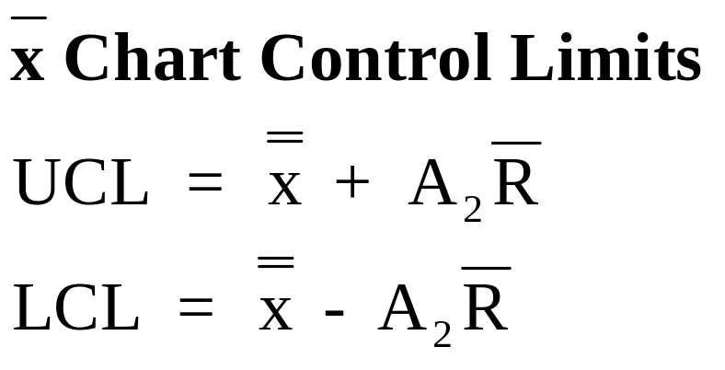
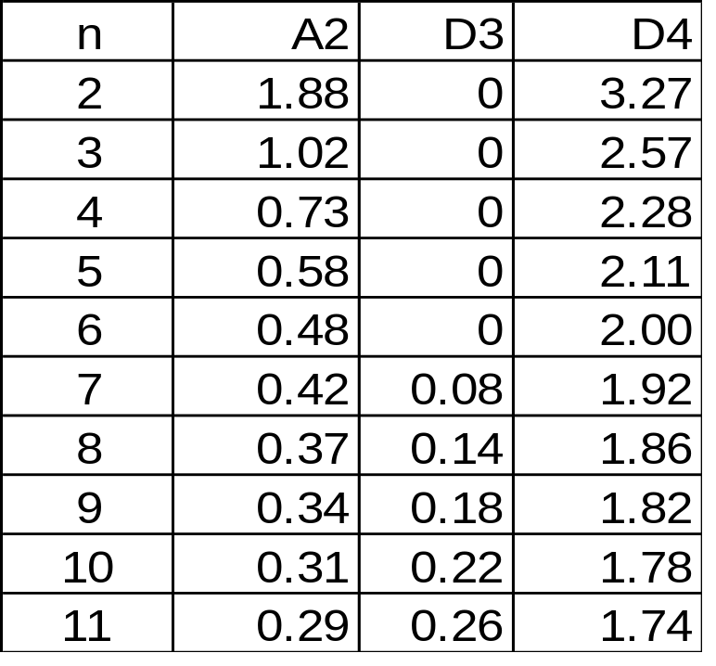
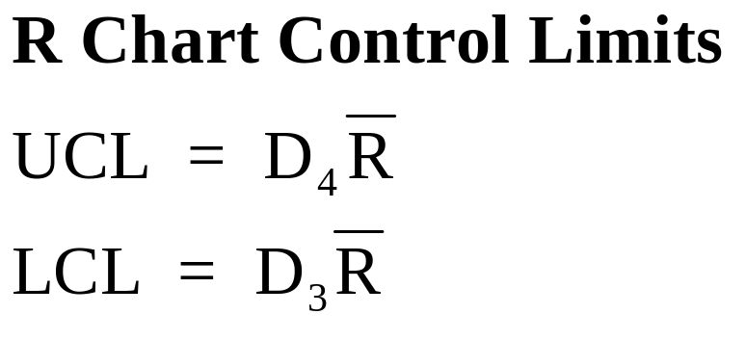
Example of x-bar and R charts: Step 2. Determine Control Limit Formulas and Necessary Tabled Values
From Exhibit TN7.7
Notes:
25

Slide 21
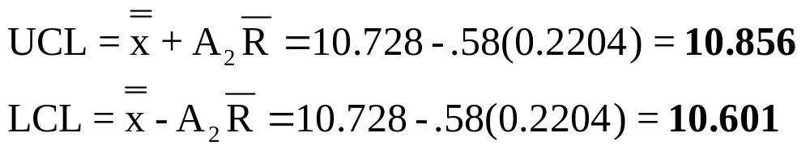
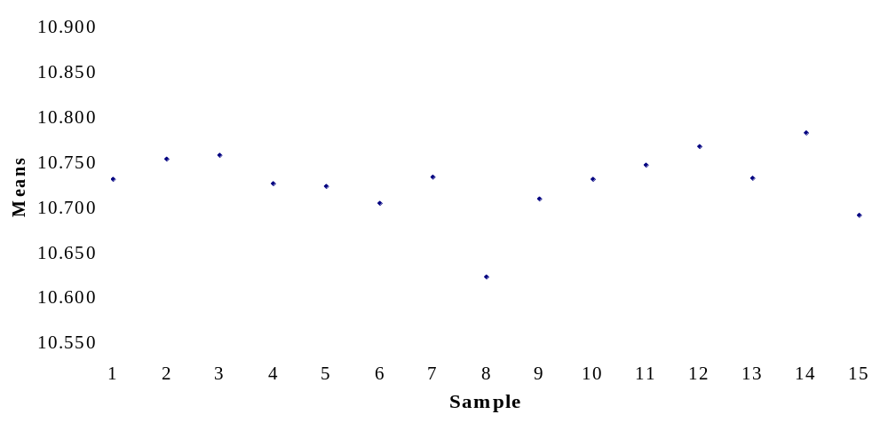
Example of x-bar and R charts: Steps 3&4. Calculate x-bar Chart and Plot Values
UCL
LCL
Notes:
26

Slide 22
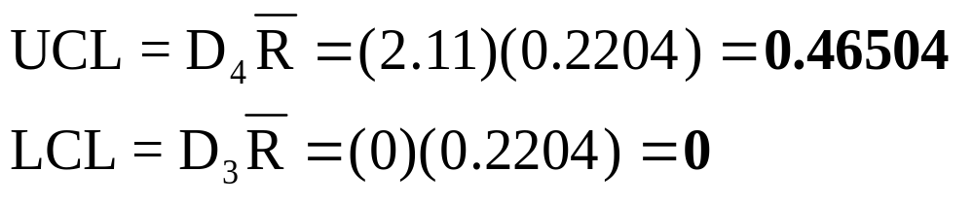
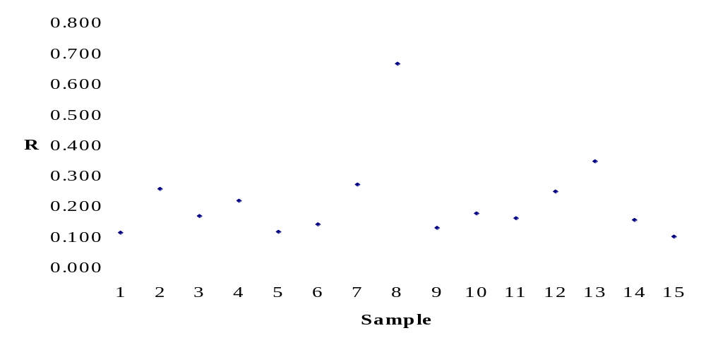
Example of x-bar and R charts: Steps 5&6. Calculate R-chart and Plot Values
UCL
LCL
Notes:
27

Slide 23
Basic Forms of Statistical Sampling for Quality Control
Acceptance Sampling is sampling to accept or reject the immediate lot of product at hand
Statistical Process Control is sampling to determine if the process is within acceptable limits
Notes:
3

Slide 24
Acceptance Sampling
Purposes
  Determine quality level
  Ensure quality is within predetermined level
Advantages
  Economy
  Less handling damage
  Fewer inspectors
  Upgrading of the inspection job
  Applicability to destructive testing
  Entire lot rejection (motivation for improvement)
Notes:
4

Slide 25
Acceptance Sampling (Continued)
Disadvantages
  Risks of accepting “bad” lots and rejecting “good” lots
  Added planning and documentation
  Sample provides less information than 100-percent inspection
Notes:
5

Slide 26
Acceptance Sampling:
Single Sampling Plan
A simple goal
Determine (1) how many units, n, to sample from a lot, and (2) the maximum number of defective items, c, that can be found in the sample before the lot is rejected
Notes:
7

Slide 27
Risk
Acceptable Quality Level (AQL)
  Max. acceptable percentage of defectives defined by producer
The α (Producer’s risk)
  The probability of rejecting a good lot
Lot Tolerance Percent Defective (LTPD)
  Percentage of defectives that defines consumer’s rejection point
The β (Consumer’s risk)
  The probability of accepting a bad lot
Notes:
8

Slide 28
Operating Characteristic Curve
The OCC brings the concepts of producer’s risk, consumer’s risk, sample size, and maximum defects allowed together
1
The shape or slope of the curve is dependent on a particular combination of the four parameters
0.9
α = .05 (producer’s risk)
0.8
0.7
n = 99
c = 4
0.6
0.5
Probability of acceptance
0.4
0.3
β =.10
(consumer’s risk)
0.2
0.1
0
1
2
3
4
5
6
7
8
9
10
11
12
AQL
LTPD
Percent defective
Notes:
9

Slide 29
Example: Acceptance Sampling Problem
Zypercom, a manufacturer of video interfaces, purchases printed wiring boards from an outside vender, Procard. Procard has set an acceptable quality level of 1% and accepts a 5% risk of rejecting lots at or below this level. Zypercom considers lots with 3% defectives to be unacceptable and will assume a 10% risk of accepting a defective lot.
Develop a sampling plan for Zypercom and determine a rule to be followed by the receiving inspection personnel.
Notes:
10

Slide 30
Example: Step 1. What is given and what is not?
In this problem, AQL is given to be 0.01 and LTDP is given to be 0.03. We are also given an alpha of 0.05 and a beta of 0.10.
What you need to determine is your sampling plan is “c” and “n.”
Notes:
11

Slide 31
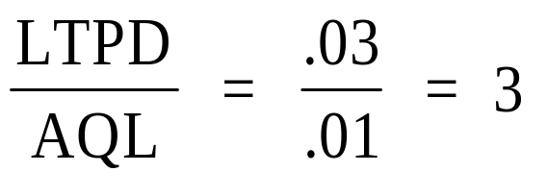
Example: Step 2. Determine “c”
First divide LTPD by AQL.
Then find the value for “c” by selecting the value in the TN7.10 “n(AQL)”column that is equal to or just greater than the ratio above.
Exhibit TN 7.10
So, c = 6.
c
LTPD/AQL
n AQL
c
LTPD/AQL
n AQL
0
44.890
0.052
5
3.549
2.613
1
10.946
0.355
6
3.206
3.286
2
6.509
0.818
7
2.957
3.981
3
4.890
1.366
8
2.768
4.695
4
4.057
1.970
9
2.618
5.426
Notes:
11

Slide 32
Example: Step 3. Determine Sample Size
Now given the information below, compute the sample size in units to generate your sampling plan
c = 6, from Table
n (AQL) = 3.286, from Table
AQL = .01, given in problem
n(AQL/AQL) = 3.286/.01 = 328.6, or 329 (always round up)
Sampling Plan:
Take a random sample of 329 units from a lot.
Reject the lot if more than 6 units are defective.
Notes:
13

Slide 33
End of Technical Note 7

